Slide 1
Visualize your city
A Data Science Project
By Sandhya Goniguntla

Slide 2
Visualization of crimes in New York and Toronto
Considering the type of neighbourhood people presently living in, they would prefer to move to a similar neighbourhood or move to another neighbourhood with better living conditions.
It is always better to be prepared before making a big move, by researching more about the city you would like to move.
This report represents statistical and visual representation of crimes in New York and Toronto using matplotlib and Folium API.

Slide 3
Data acquisition and Pre-Processing
New York city crime data acquisition:
NYPD Complaint Data Historic: Data which is available at Kaggle. This dataset has all the crimes reported in the years 2013 to 2015 and has 24 features and 1048575 samples. The dataset is checked for any missing data fields of interest and missing rows are dropped.
New York city Borough boundaries, New York city Police Precinct boundaries: geojson format files which are available at NYC open data
Neighbourhood location data: To get the location data of New York city precincts from Foursquare this file is used . The results for all the 5 borough data frames are cleaned by removing repeated, unwanted rows and merged to NY precincts data frame.

Slide 4
Data acquisition and Pre-Processing
Toronto city crime data acquisition:
Major Crime Indicators(MCI) 2014 to 2019: Available at Toronto Public Safety Data Portal.
The data is checked for missing rows for the fields and missing rows are deleted. Unwanted column fields are deleted.
Toronto city divisions boundaries: geojson file available at Toronto Public Safety Data Portal.

Slide 5
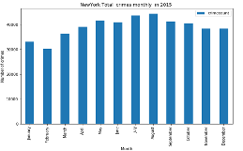
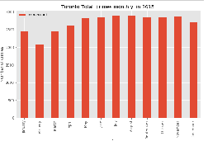
Highest crimes have occurred in August and July months in both the cities
New York Monthly crimes
Toronto Monthly crimes

Slide 6
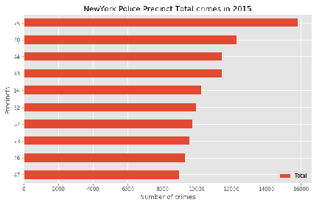
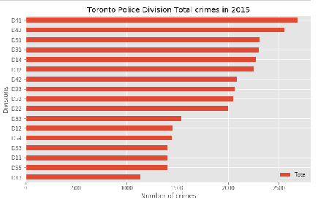
New York precinct 75 Toronto division 41 has the highest number of crimes in in the year 2015
New York crimes in Police precincts
Toronto crimes in police divisions

Slide 7
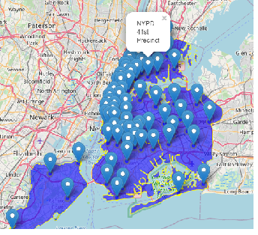
New York Police Divisions locations
This location data is extracted using Foursquare API

Slide 8
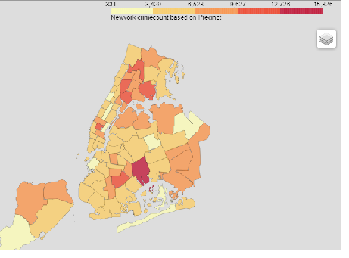
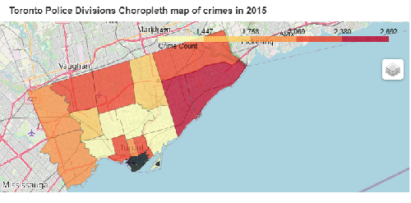
Choropleth maps are shaded according to the 6 bins provided with dark red as maximum number of crimes. Unavailable data is shaded black by default
New York crimes in police precincts
Toronto crimes in police divisions

Slide 9
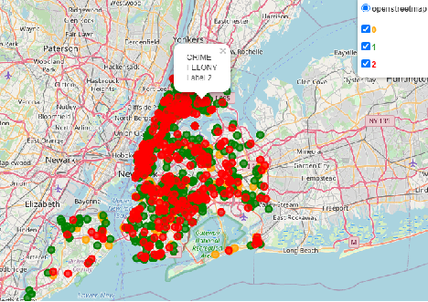
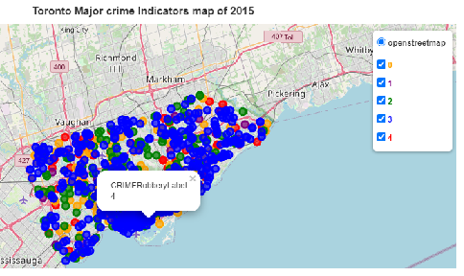
1000 randomly selected crime data is colour coded as Red(high intensity),Green and Orange(low intensity)
Interactive map New York crimes
Interactive map Toronto crimes

Slide 10
Conclusion
The analysis can be extended by finding the crime rate and ranking the place on a scale of 1 (low crime rate) to 10 (high crime rate).
CRIME RATE – A crime rate describes the number of crimes reported to law enforcement agencies per 100,000 total populations. A crime rate is calculated by dividing the number of reported crimes by the total population; the result is multiplied by 100,000.
By using neighbourhood crime data and population of New York(if available) and Toronto cities crime rate can be calculated and visualized using choropleth maps

